Slide 1
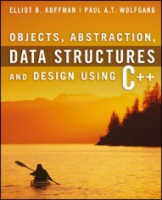
Welcome to
CS 235 Data Structures
Sequential Containers, 4.3-4 (12)

Slide 2
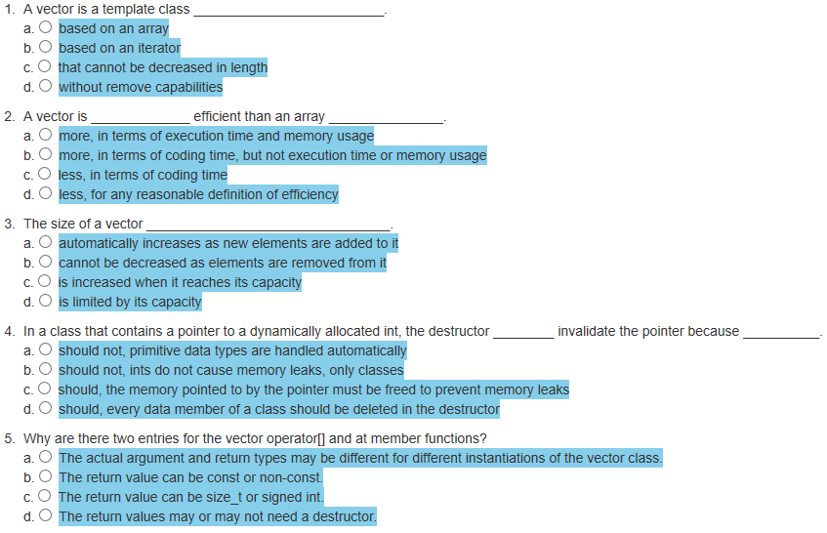
Attendance Quiz #11

Slide 3
Tip #12: File Organization (Best Practice)
File extensions are only meaningful for the operating system.
Best practice states:
.h and .hpp files are for cross file data type declarations. They should have header guards and NEVER allocate (instantiate) any memory.
.cpp files are for memory allocations (ie, regular function code and global variables) as well as non-template class method definitions (implementation of method).
Class method definitions can be inside or outside the class declaration (using the resolution operator "::").
The class method definitions (implementation) can be in the .h file containing the declaration or a separate .cpp file (using the same name as the .h file.)
Often, one .h/.cpp file combination is used for each class.
If the class method definition (implementation) is more than 10 lines, the declaration and definition are combined to aid the compiler in possible in-lining of the function.
NOTE: The exception to the above recommendation is when creating a class template where the method declaration and definition MUST BE in the same file.

Slide 4
#include <iostream>
using namespace std;
#include "Dog.h"
int main()
{
Dog rover;
cout << rover.getBarks();
return 0;
}
#include <iostream>
using namespace std;
#include "Dog.h"
int main()
{
Dog rover;
cout << rover.getBarks();
return 0;
}
main.cpp
main.cpp
#ifndef DOG_H
#define DOG_H
class Dog
{
private:
int bark;
public:
Dog();
~Dog();
int getBarks();
int bigDog();
};
#endif
#ifndef DOG_H
#define DOG_H
class Dog
{
private:
int bark;
public:
Dog() : bark(0) {}
~Dog() {};
int getBarks() { return bark; }
int bigDog();
};
#endif
Dog.h
Dog.h
10 or less
lines
more than 10 lines
#include "Dog.h"
Dog::Dog() : bark(0) {}
Dog::~Dog() {};
int Dog::getBarks() { return bark; }
// Big function
int Dog::bigDog()
{
// >10 lines of code...
return 0;
}
#include "Dog.h"
// Big function
int Dog::bigDog()
{
// >10 lines of code...
return 0;
}
Dog.cpp
✗
Dog.cpp

Slide 5
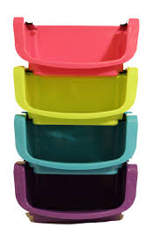
4.3 Implementation of a Vector Class
The Default Constructor
The swap Function
The Subscripting Operator
The push_back Function
The insert Function
The erase Function
The reserve Function
Performance of the KW::Vector
4.3, pgs. 240-246

Slide 6
A Vector Class Object
template<typename T>
class Vector
{
private:
// Data fields
/** The initial capacity of the array */
static const size_t INITIAL_CAPACITY = 10;
/** The current capacity of the array */
size_t current_capacity;
/** The current num_items of the array */
size_t num_items;
/** The array to contain the data */
T* the_data;
public:
// Member Functions
...
};
We will implement a simplified version of the vector class.
The physical size of the array is indicated by the data field current_capacity (type size_t because it must be non-negative)
The number of data items stored is indicated by the data field num_items
The vector data items are stored in a dynamic array pointed to by the_data

Slide 7
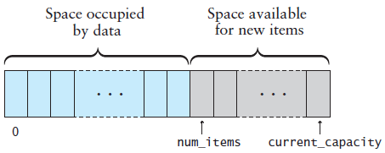
Vector Default Constructor
template<typename T>
class Vector
{
private:
// Data fields
...
public:
// Member Functions
/** Construct an empty vector w/default capacity */
Vector<T>() : current_capacity(INITIAL_CAPACITY),
the_data(new T[INITIAL_CAPACITY]),
num_items(0) {}
};
Initializer List.
current_capacity = INITIAL_CAPACITY;
the_data = new T[INITIAL_CAPACITY];
num_items = 0;

Slide 8
Vector at / Index Operator
template<typename T>
class Vector
{
private:
// Data fields
...
public:
/** Subscripting operator */
T& operator[](size_t index) { return the_data[index]; }
/** at member function */
T& at(size_t index)
{
if (index >= num_items) // Verify valid index.
{
throw std::out_of_range("index to operator[] is out of range");
}
return the_data[index];
}
};
Because this is a template class, all of the code must be in the header or in a file included by the header .
In the STL vector, only the at function validates the index.
The index is valid, so just use the index operator.

Slide 9
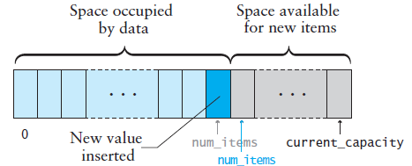
Vector push_back() Function
void push_back(const T& the_value)
{
// Make sure there is space for the new item.
if (num_items == current_capacity)
{
reserve(2 * current_capacity); // Double the capacity
}
// Insert the new item.
the_data[num_items] = the_value;
num_items++;
}
Requests the vector capacity to be double the current capacity.

Slide 10
Vector reserve() Function
The reserve function is called by push_back() and insert() functions if the vector size would exceed its capacity.
Requests the vector capacity to be at least enough to contain new_capacity elements.
void reserve(size_t new_capacity)
{
if (new_capacity > current_capacity)
{
T* new_data = new T[new_capacity];
for (size_t i = 0; i < num_items; i++)
new_data[i] = the_data[i];
delete[] the_data;
the_data = new_data;
current_capacity = new_capacity;
}
}
Copy old data to the new array.
Free old memory.
Point the vector to the new data.
Although reallocation is O(n), if we double an array of size n, then we can add n more items before another array copy is needed (which averages out to 1 copy per add, so reallocation is effectively an O(1) operation).
Hence, push_back() is performed in amortized constant time.

Slide 11
Vector insert() Function
void insert(size_t index, const T& the_value)
{
for (size_t i = num_items; i > index; i--) // Open a slot
{
the_data[i] = the_data[i - 1];
}
the_data[index] = the_value; // Insert new item
num_items++;
}
if (index > num_items) // Validate index.
{
throw std::out_of_range("Insert index is out of range");
}
if (num_items == current_capacity) // Check for room
{
reserve(2 * current_capacity); // Double the capacity
}

Slide 12
Vector erase() Function
void erase(size_t index)
{
// Validate index.
if (index > num_items)
{
throw std::out_of_range("Erase index is out of range");
}
// Move items below the removed one up.
for (size_t i = index + 1; i < num_items; i++)
{
the_data[i - 1] = the_data[i];
}
num_items--;
}

Slide 13
Performance of Vector
The functions operator[] and at are each a few lines of code and contain no loops - execute in constant time, or O(1).
If we insert into (or remove from) the middle of a vector, then at most n items have to be shifted, which is O(n).
What if we have to reallocate before we can insert?
Reallocation is O(n), but...
We wouldn't need to reallocate again for another n insertions.
Hence, we spread out the cost of reallocation so that effectively it is an O(1) operation (O(n) / n), so the insertion is still O(n) .
Even if we don’t spread out the cost of copying, the copy operation is still O(n), so the worst case merely doubles the cost.
The functions push_back() and insert() are performed in amortized constant time.

Slide 14
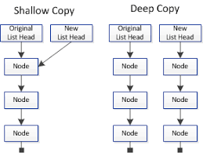
4.4 The Copy Constructor, Assignment Operator, and Destructor
Copying Objects and the Copy Constructor
Shallow Copy versus Deep Copy
Assignment Operator
The Destructor
4.4, pgs. 247-251

Slide 15
Copying Objects
Applications require that a copy of an object be an independent copy, which means being able to modify one of the objects without affecting the other.
Copying of primitive types is straightforward—the values are duplicated and placed in the target locations (shallow).
If the object references a dynamically allocated object, the memory allocated to that object must be freed (deep).
The Gang of Three Rule basically states that if a class defines one (or more) of the following, it should probably explicitly define all three:
Copy constructor – create new object members from corresponding member constructors.
Copy assignment operator – assign corresponding members from existing members.
Destructor – call the destructors of all the object's class-type members.
The default constructors and assignment operators only do shallow copies.
Destructors contain code that is run whenever an object is destroyed.
An explicit deep copy constructor, assignment operator, and destructor must be created when a class contains pointers to dynamically allocated resources.

Slide 16
Copy Constructor / Assignment Operator
To create an independent copy of an object, the
Copy constructor is called when a new object is created from an existing object:
MyClass t1, t2; // default constructor
MyClass t3 = t1; // copy constructor (t3 is new)
Assignment operator is called when an already initialized object is assigned a new value from another existing object.
t2 = t1; // assignment operator (t2 exists)
t2.operator=(t1); // assignment operator (equivalent)
Examples:
Dog butch("Butch"); // Parameterized constructor of butch
Dog skippy(); // Default constructor of skippy
skippy = butch; // assignment operator
The copy constructor is invoked automatically:
when an object is passed to a function by value.
when an object is returned from a function.
when an object is initialized with another object of the same class.
when the compiler generates a temporary object.

Slide 17
Shallow Copy
Referring back to our vector class, copying current_capacity and num_items fields create independent copies of the variables.
However, copying the pointer value the_data does not create an independent copy.
Copying a pointer this way is considered a shallow copy.
1
2
3
4
5
Vector<int> v1
num_items = 5 current_capacity = 8 int* the_data = _____
Vector<int> v2 = v1;
Vector<int> v2
num_items = 5 current_capacity = 8 int* the_data = _____

Slide 18
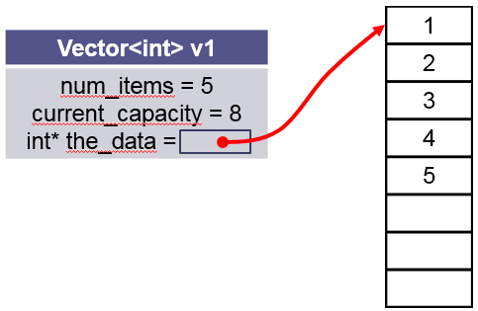
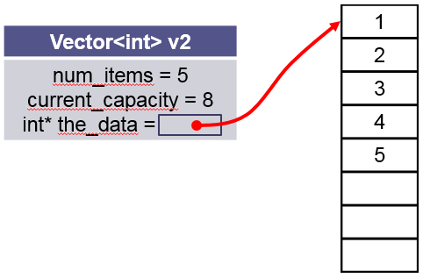
Deep Copy Constructor
We need to create an independent copy or a deep copy of the underlying array so that v1.the_data and v2.the_data point to different arrays, making vector v2 a deep copy of vector.
/** Make a (deep) copy of a vector.
@param other The vector to be copied
*/
Vector<T>(const Vector<T>& other)
: current_capacity(other.capacity),
num_items(other.num_items),
the_data(new T[other.current_capacity])
{
for (size_t i = 0; i < num_items; i++)
{
the_data[i] = other.the_data[i];
}
}

Slide 19
Deep Assignment Operator
/** Assign the contents of one vector to another.
@param other The vector to be assigned to this vector
@return This vector with a copy of the other vector's contents
*/
Vector<T>& operator=(const vector<T>& other)
{
// Make a copy of the other vector.
Vector<T> the_copy(other);
// Swap contents of self with the copy.
this->swap(the_copy);
// Return self (the copy will be deleted)
return *this;
}
Vector<int> v1();
Vector<int> v2();
v2 = v1;
this
other
Make a copy of v1 using the vector copy constructor (v1 → the_copy)
Exchange v2 (this) and the_copy (only exchange pointers) (v2 ←→ the_copy)
v2 is now the_copy (V1) and so return v2 (*this) (v2 ← v1)
Note: the_copy is deleted by the local destructor.

Slide 20
The Destructor
The purpose of the destructor is to undo what the constructor does.
The constructor takes a block of uninitialized memory and sets it to a valid state, thus creating an object.
When the destructor is finished, the object is in an invalid state and the memory it occupies can be reused for creating other objects.
If this is not done, the program will have memory leaks.
Each class has a default destructor, which effectively invokes the destructor for each data field.
If the pointer references a dynamically allocated object (such as the array referenced by pointer the_data), the memory allocated to that object must be freed.

Slide 21
Be Safe

